Slide 1
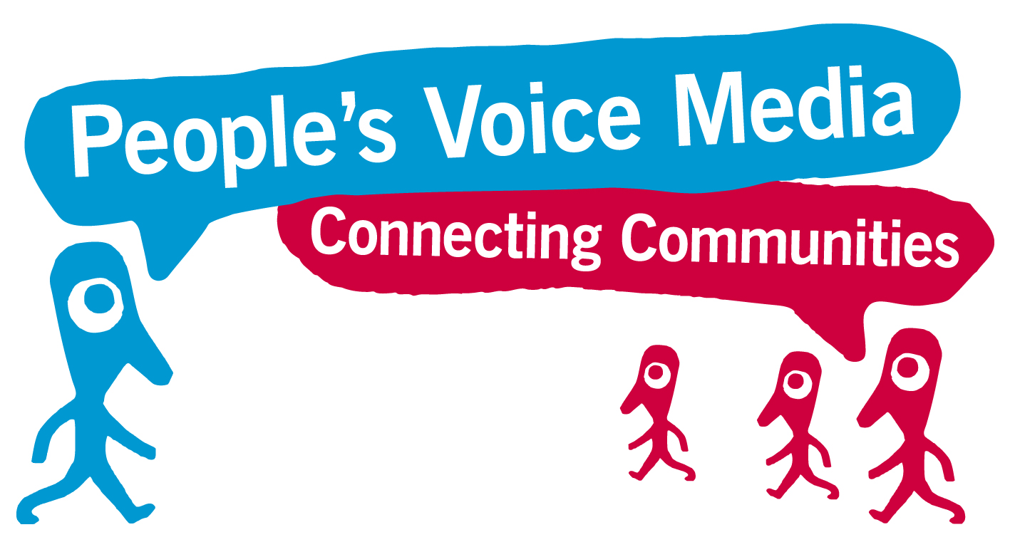
Measuring the impact of your work with volunteers
Using ripple effect mapping
Notes:
Title slide 1

Slide 2
Agenda
This session covers the following:
What is Ripple Effect Mapping?
Ripple Effect Mapping activity
Notes:
Custom layout

Slide 3
So you want to measure your impact?
Measuring the impact of your work with volunteers can be difficult, as it involves many moving parts and stories that are difficult to quantify.
Ripple effect mapping is a technique that is designed to capture the ‘ripples’ of impact that are hard to measure by more traditional methods or that don't happen immediately.
Notes:
Custom layout

Slide 4
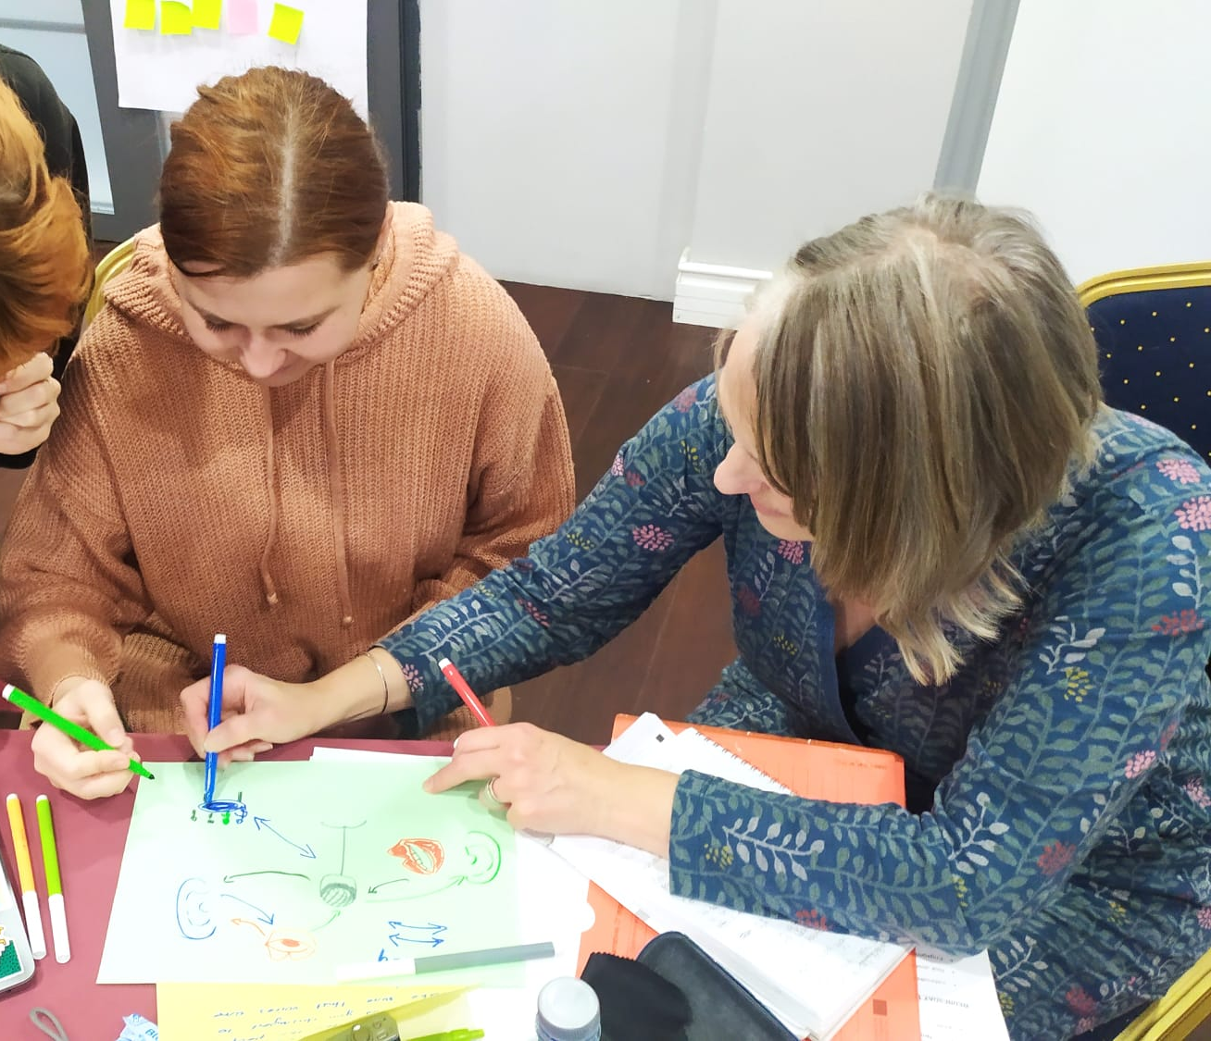
What is Ripple Effect Mapping?
It is a technique for impact evaluation, specifically designed for community-based programmes and projects.
It involves people who are a part of process/project reflecting on and visually mapping intended and unintended changes.
Notes:
Side by side content 1

Slide 5
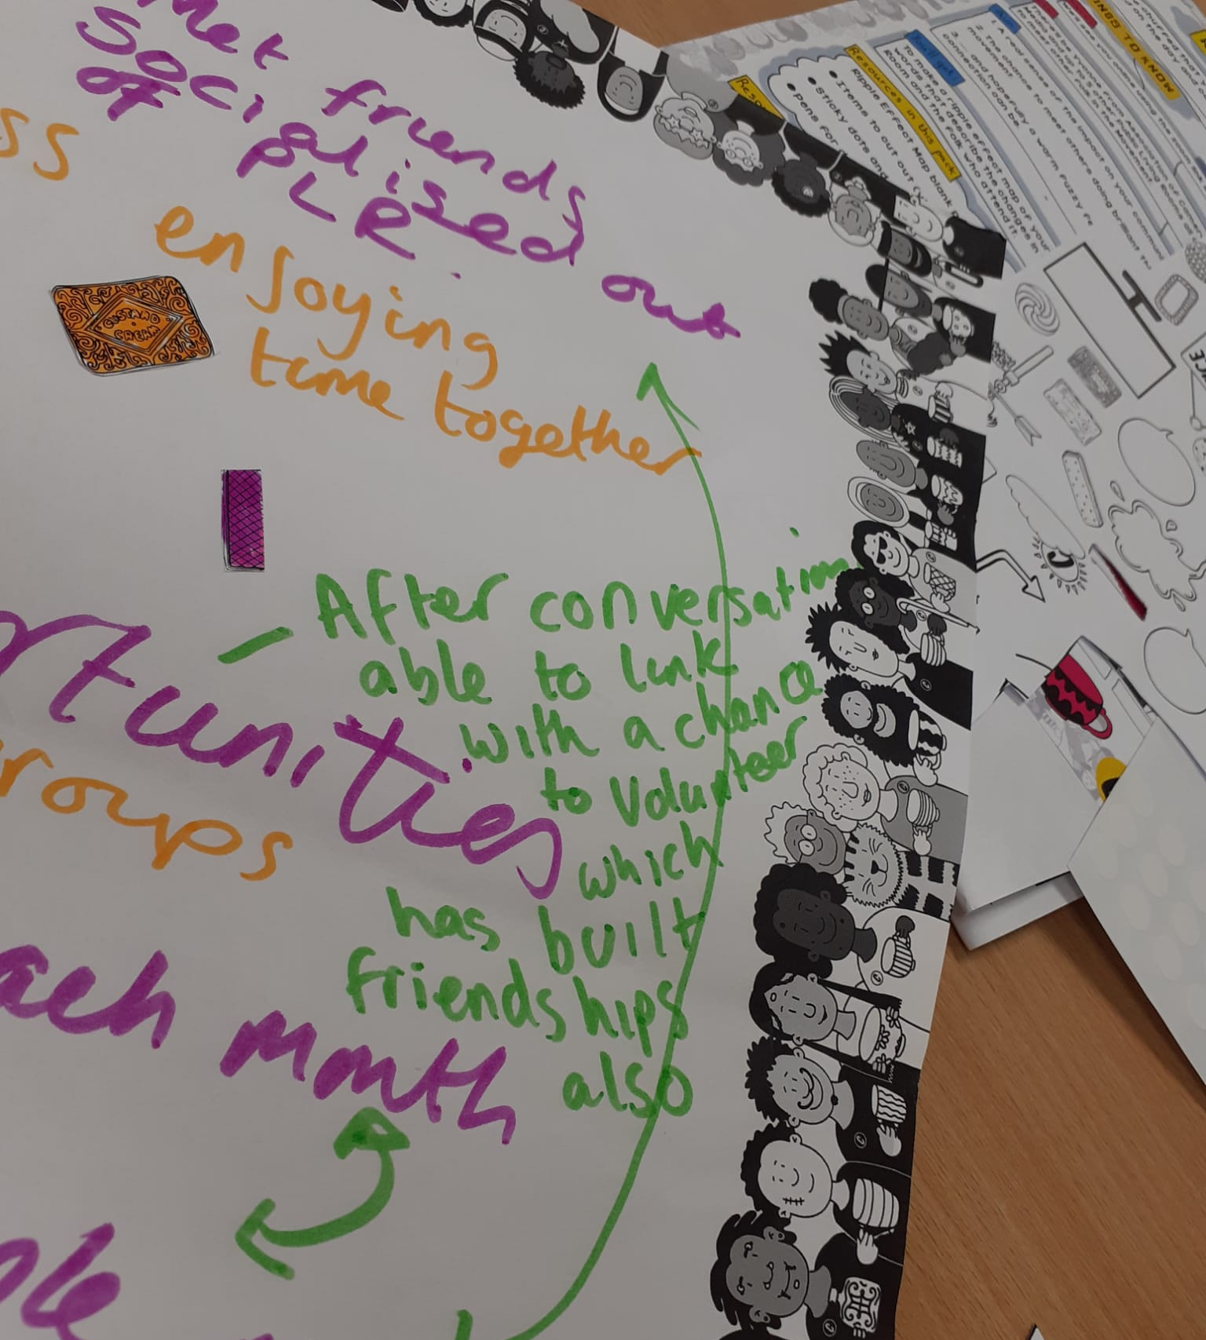
What is Ripple Effect Mapping?
The method is:
Participatory and interactive – i.e., it involves you!
Iterative and conclusive – i.e., it can be used in the middle or end of projects
Adaptable to unique contexts – i.e., easy to make it fit our needs
Notes:
Side by side content 1

Slide 6
Who should be involved?
Ripple effect mapping works best when you have a group of people who are all involved in the organisation, project or aim you're evaluating working on the same map
You want as many different perspectives as possible – so invite the CEO, a couple of volunteers, your volunteer manager and anyone in between
Notes:
Custom layout

Slide 7
What are 'ripples'?
Ripples are the impacts of actions, and then the impacts of those impacts, and the impacts of those impacts and so on
i.e. because we took x action, y happened, and because y happened, z happened
These can be simple or complex, personal or organisational, new actions or measurable outcomes
Notes:
Custom layout

Slide 8
Example – from the action on the left, we have identified these subsequent 'ripples' of impact
Recruited 10 new volunteers.
Saw an increase in applications (give figures if you have them)
Started accepting video applications as well as written applications.
Our volunteers now represent a more diverse range of backgrounds (be as specific as you can)
Held a Diwali celebration event for the residents in our care home led by volunteers. People learned new craft skills and had a great time!
Learned about the Vision for Volunteering and wanted to change our recruitment processes to open access to our volunteering roles
Formed a partnership with a local temple.
We have volunteers taking on new roles. e.g. social media which has attracted younger volunteers.
Milly, our youngest volunteer, has set us up on TikTok and we are attracting new donations using the platform.
Introduced entrance interviews where we work with new volunteers to build a role that suits them.
Katie started volunteering with us as we were able to build a role that fit around her childcare. She has since brought along two of her mum friends to join the volunteer team.
One of the mum volunteers has now started a Health and Social Care qualification as a result of her volunteering experiences.
Notes:
Custom layout

Slide 9
How do you create a ripple effect map?
Start with your organisation, project or aim in the centre
Identify the actions or changes you have made and write these around the centre like a mind map
Identify the 'ripples' of impact that these actions/changes have had and write these as another layer
Carry on until you run out of space or run out of impacts!
Notes:
Custom layout

Slide 10
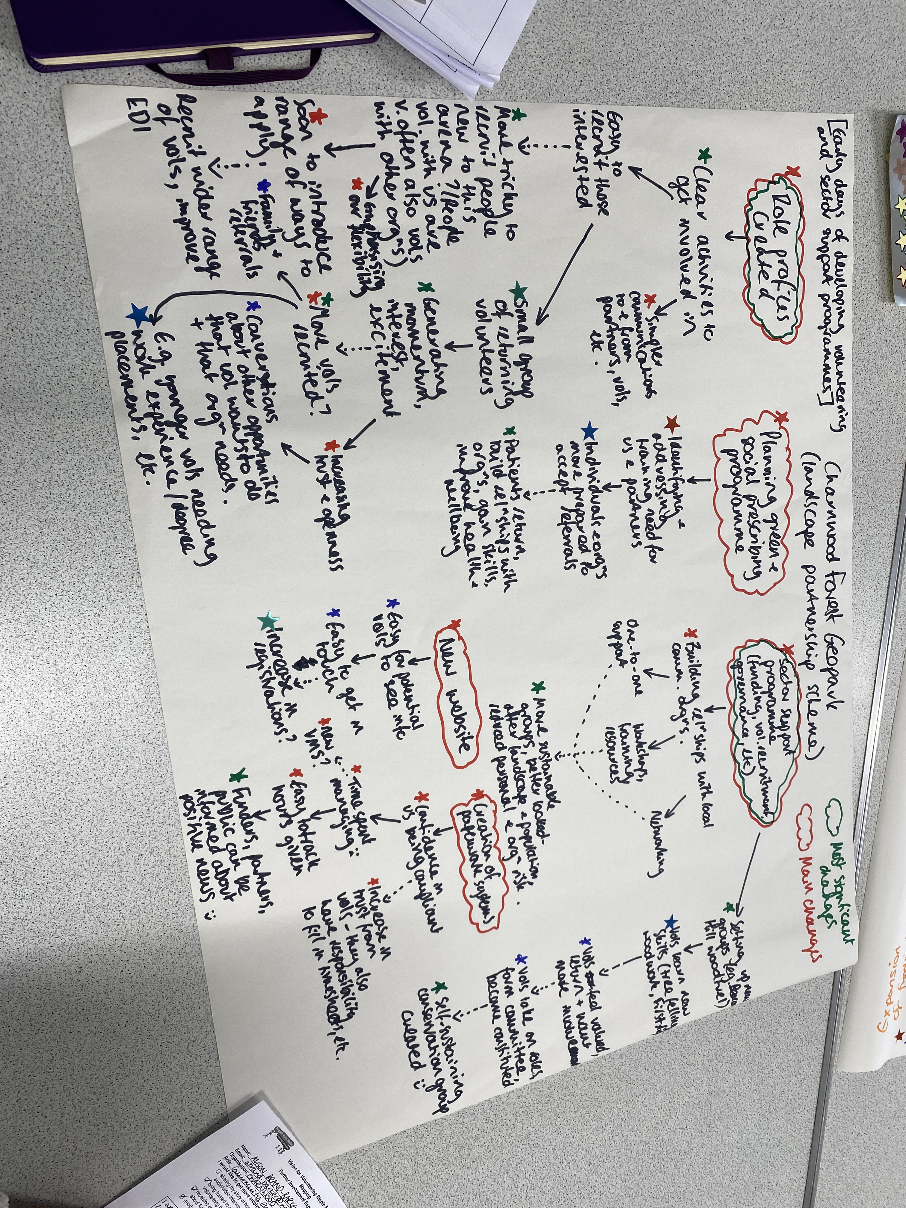
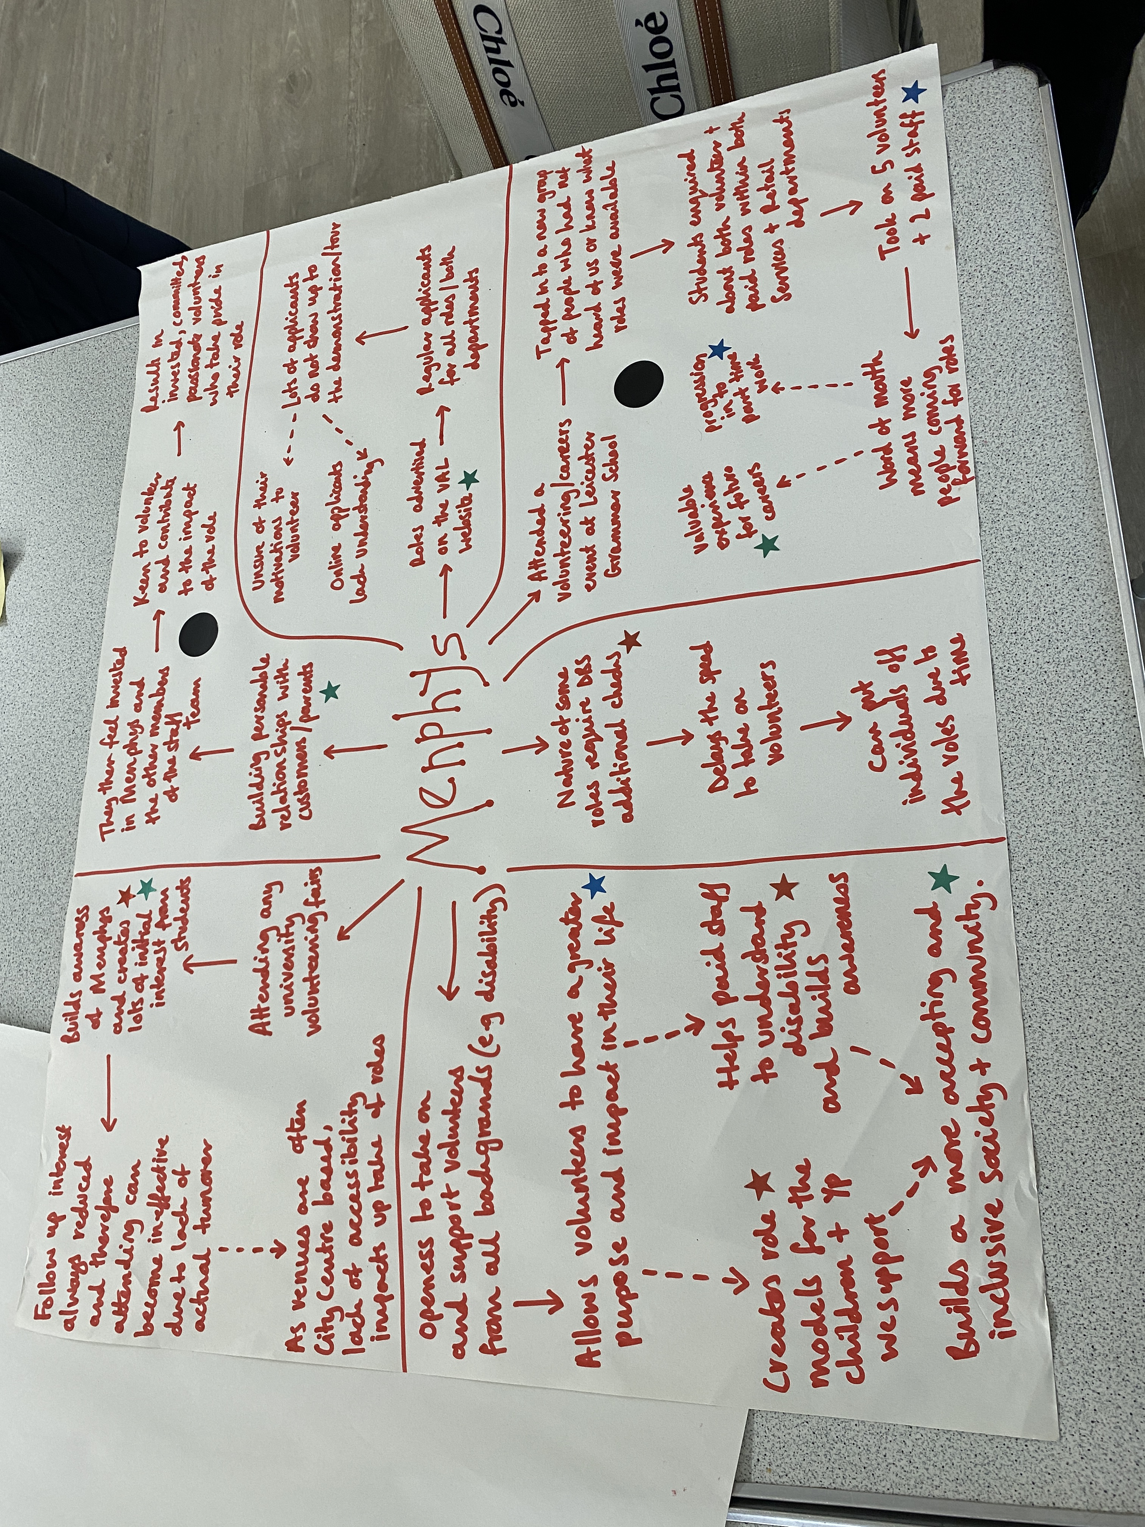
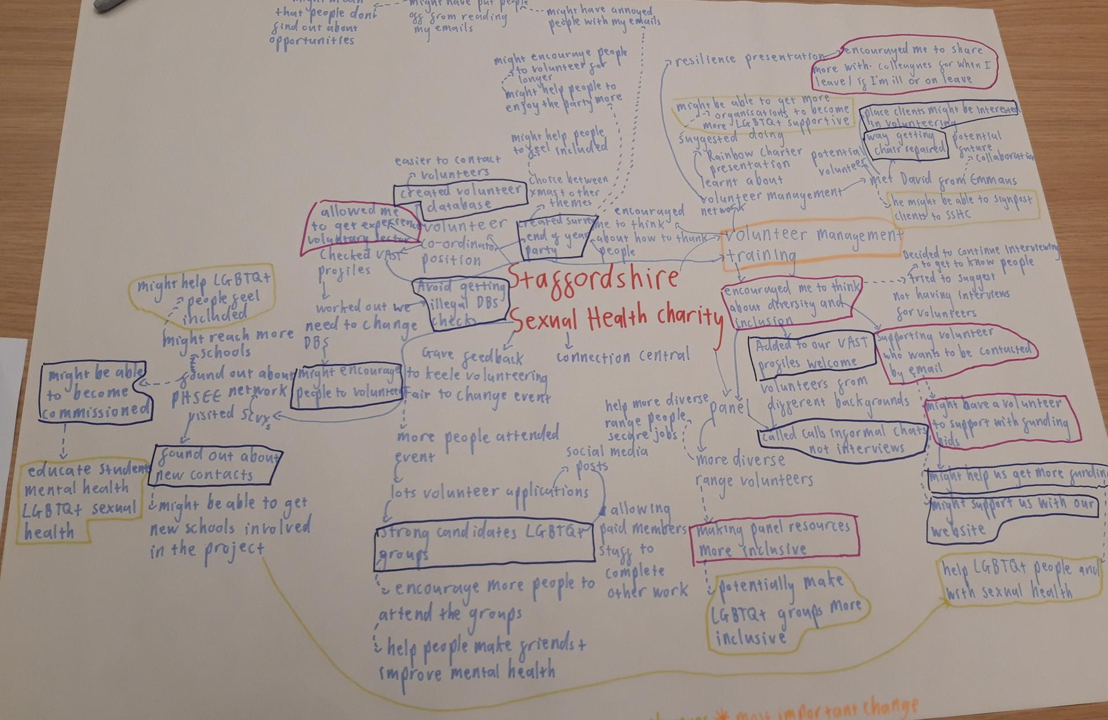
Some examples

Slide 11
Create your ripple effect map
Now's the time to create your map! Grab some pen or paper or use an online whiteboard tool such as Miro and Flinga.
Creating your map can take as short or long as you like, but we'd suggest taking 30 mins – 1 hour. Remember you can keep going on another page if you run out of space.

Slide 12
Enhance your map
You can enhance your map by adding some features such as:
Use coloured stickers to indicate whether an impact relates to an individual change, an organisational change or a wider community/society change
Get everyone who's worked on your map to identify what they think is the most significant change
Notes:
Title and content 1

Slide 13
What next?
Congrats! You've got a ripple effect map! You can now use this to help demonstrate the impact of your project
You can use it as it is, or use it as the foundation for outcome monitoring, creating a logic model of change or planning future interventions
You can repeat the ripple effect mapping exercise at any point throughout the project to see how the impacts have developed or changed

